Slide 1
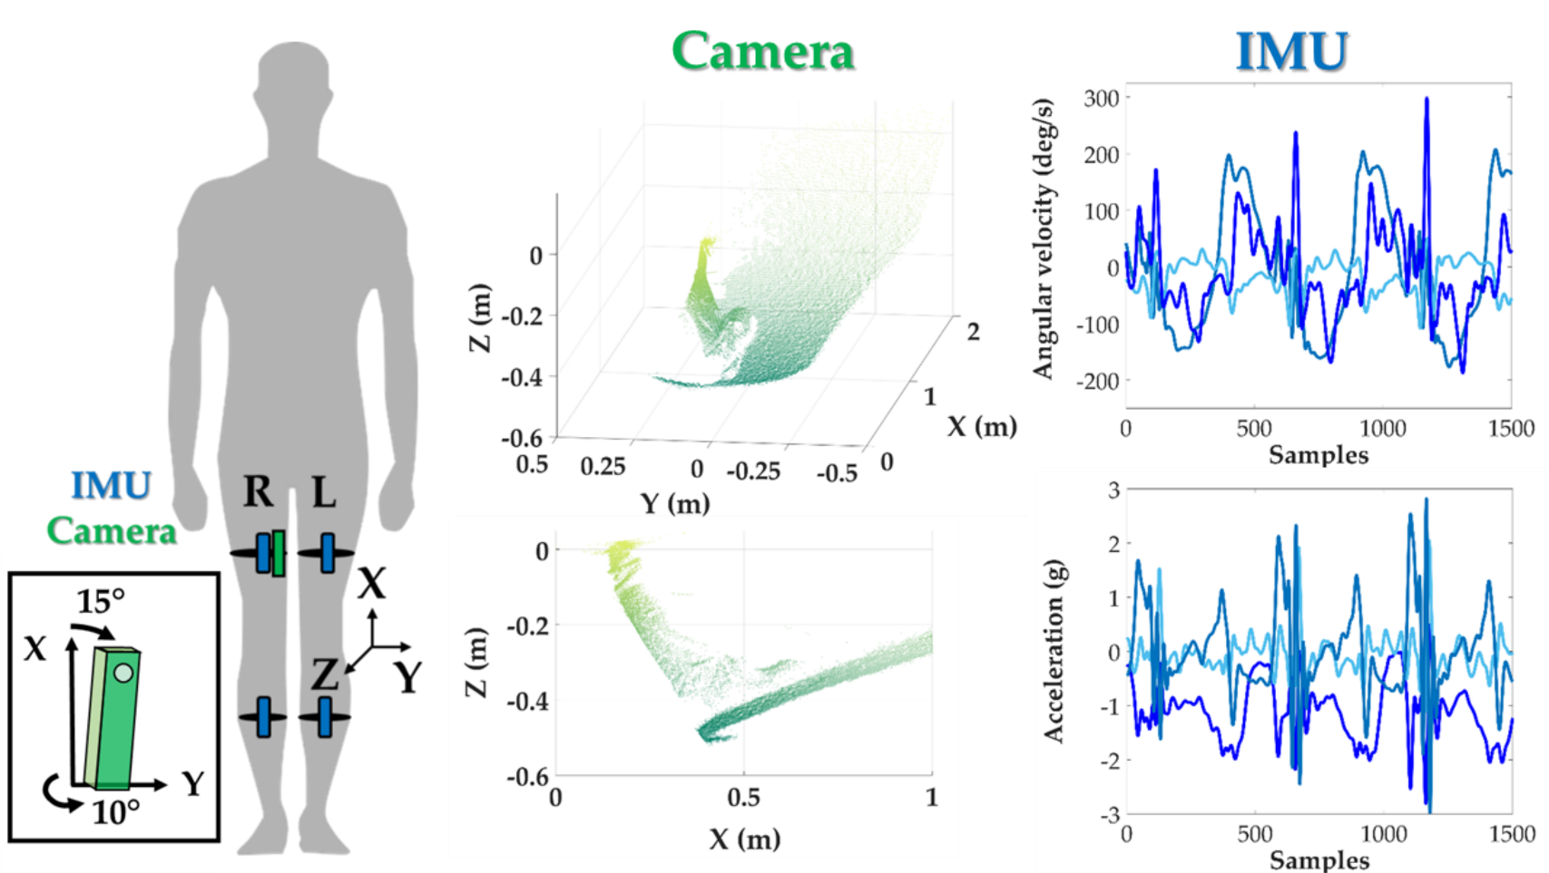

Slide 2
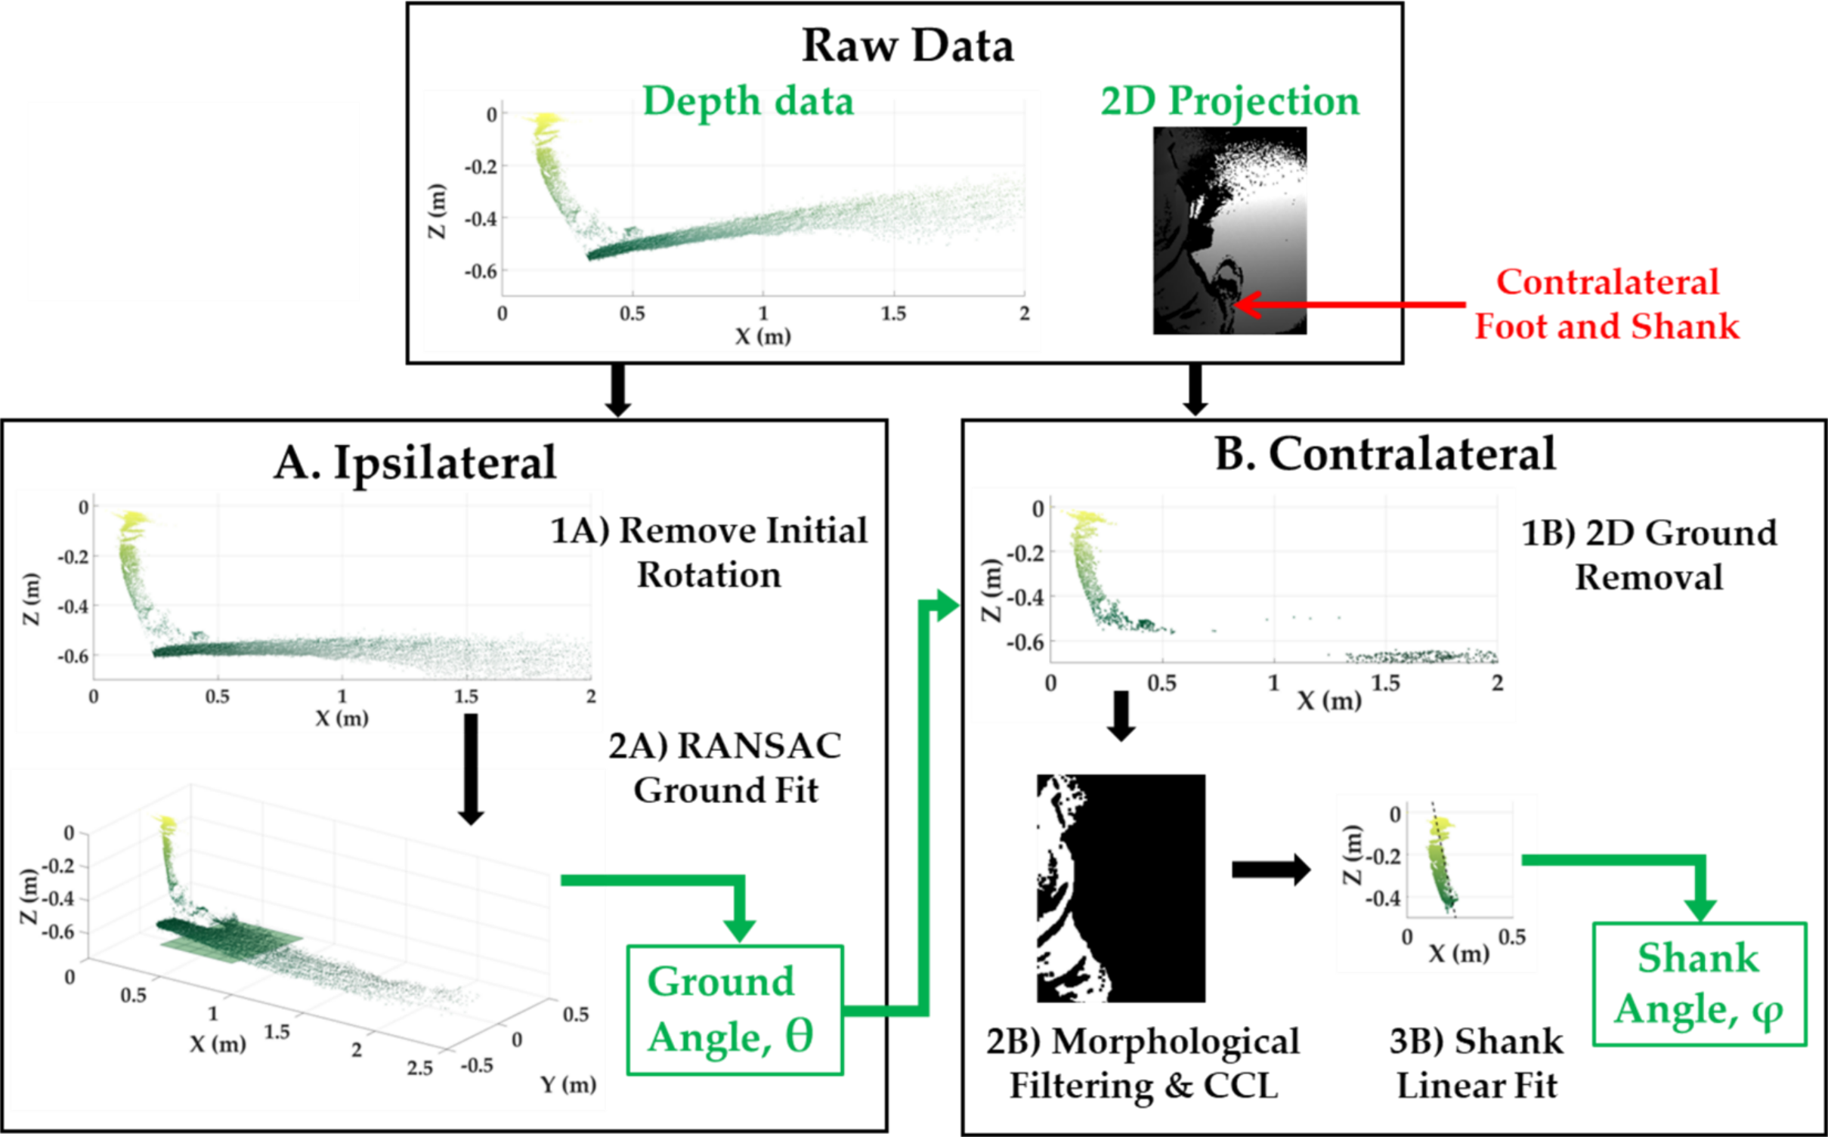

Slide 3
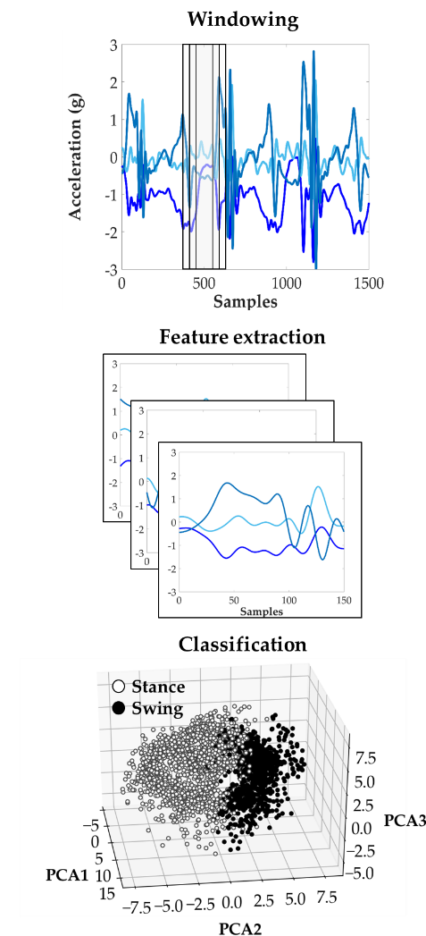

Slide 4
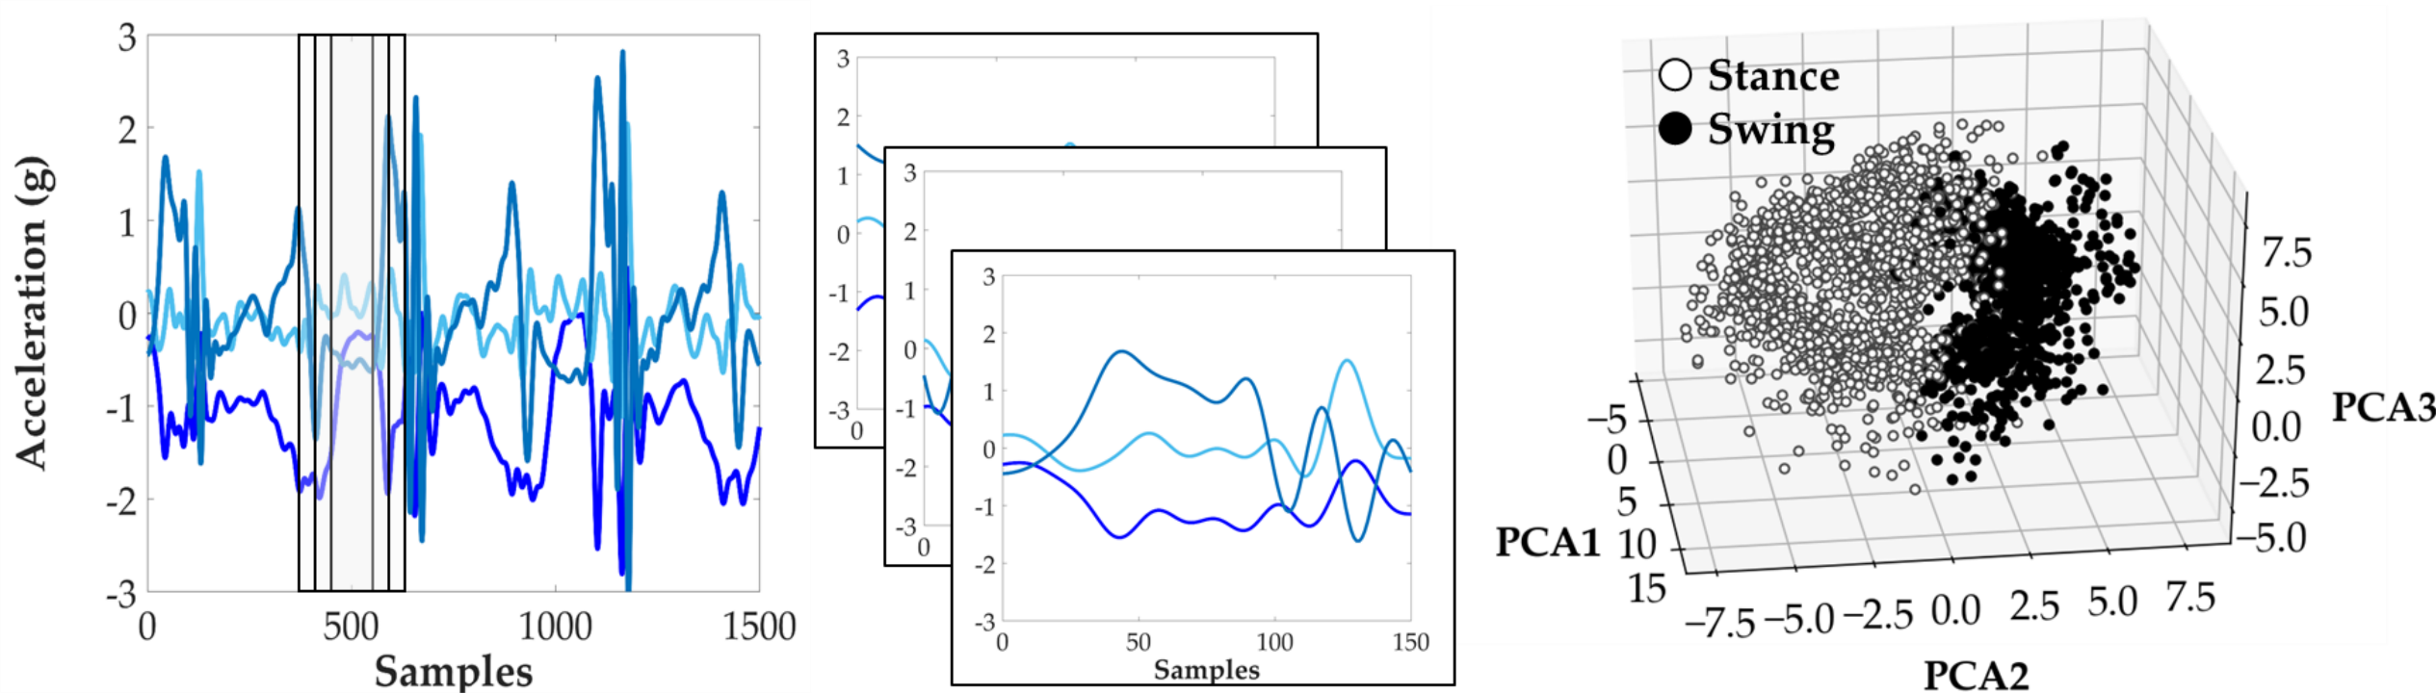
Windowing
Feature extraction
Classification

Slide 5
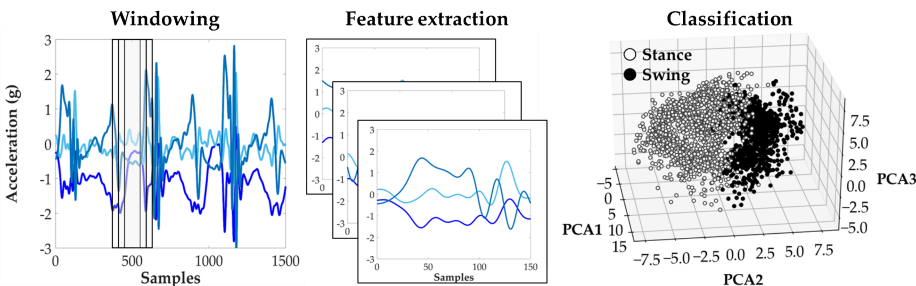

Slide 6
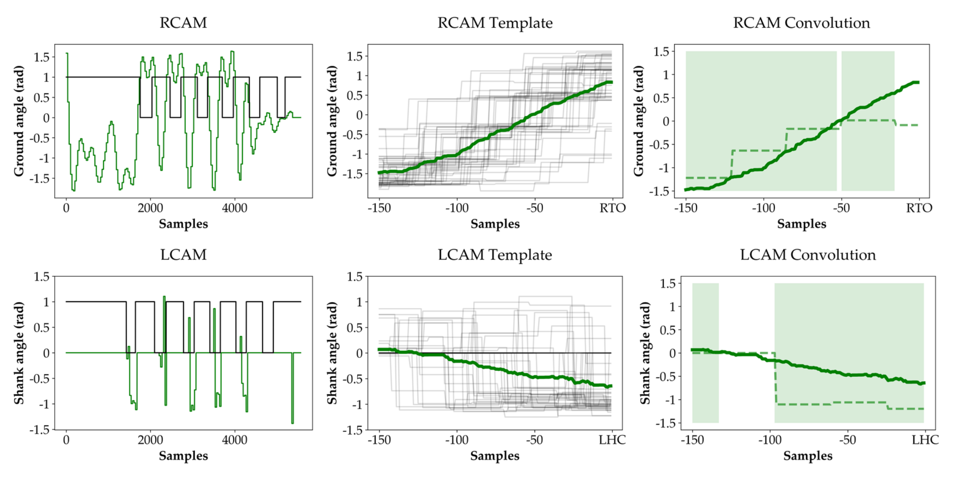

Slide 7
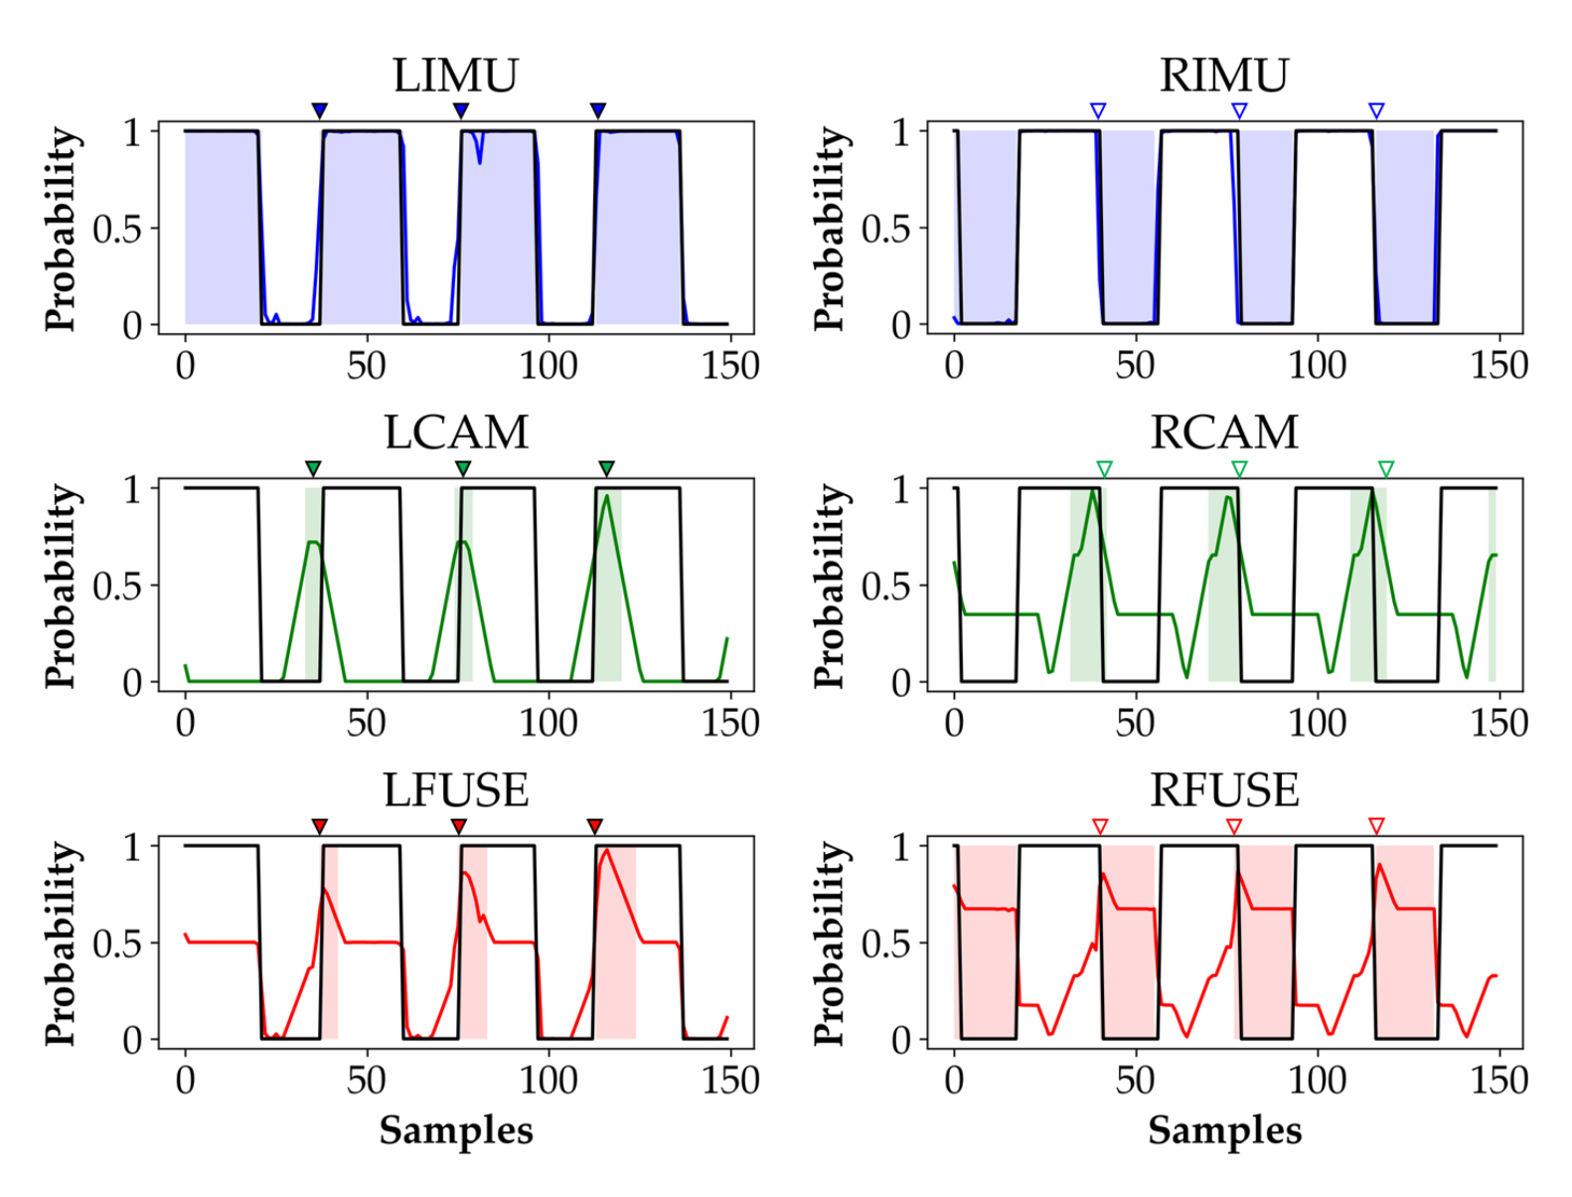

Slide 8
LHC (n = 57) | Mean (ms) | SD (ms) | Outliers
R Thigh | -23 | 69 | 0
R Thigh + Shank | -8 | 56 | 0
R/L Thigh + Shank | -4 | 30 | 0
CAM | 3 | 106 | 10
FUSED | -13 | 61 | 3
RTO (n = 54) | Mean (ms) | SD (ms) | Outliers
R Thigh | -6 | 41 | 0
R Thigh + Shank | 1 | 42 | 0
R/L Thigh + Shank | -9 | 42 | 0
CAM | -7 | 85 | 0
FUSED | -5 | 39 | 0
LDA

Slide 9
LHC (n = 57) | Mean (ms) | SD (ms) | Outliers
R Thigh | -23 | 69 | 0
R Thigh + Shank | -8 | 56 | 0
R/L Thigh + Shank | -4 | 30 | 0
CAM | -34 | 107 | 7
FUSED | -15 | 63 | 6
RTO (n = 54) | Mean (ms) | SD (ms) | Outliers
R Thigh | -6 | 41 | 0
R Thigh + Shank | 1 | 42 | 0
R/L Thigh + Shank | -9 | 42 | 0
CAM | -7 | 85 | 0
FUSED | -5 | 39 | 0
LDA
Redo
Using
Non-binarized
LHC feature

Slide 10
LHC (n = 57) | Mean (ms) | SD (ms) | Outliers
R Thigh | -23 | 69 | 0
R Thigh + Shank | -8 | 56 | 0
R/L Thigh + Shank | -4 | 30 | 0
CAM | -34 | 107 | 7
FUSED | -15 | 63 | 6
RTO (n = 54) | Mean (ms) | SD (ms) | Outliers
R Thigh | -4 | 40 | 0
R Thigh + Shank | 1 | 42 | 0
R/L Thigh + Shank | -9 | 42 | 0
CAM | -3 | 84 | 0
FUSED | -1 | 42 | 0
LDA
Redo
Using
Non-binarized
LHC feature
And
New Processed
Files

Slide 11
LHC (n = 57) | Mean (ms) | SD (ms) | Outliers
R Thigh | -34 | 96 | 0
R Thigh + Shank | -25 | 80 | 2
R/L Thigh + Shank | -18 | 66 | 1
CAM | 3 | 106 | 10
FUSED | -16 | 63 | 2
RTO (n = 54) | Mean (ms) | SD (ms) | Outliers
R Thigh | 7 | 30 | 1
R Thigh + Shank | 11 | 63 | 0
R/L Thigh + Shank | 15 | 70 | 1
CAM | -7 | 85 | 0
FUSED | 13 | 60 | 0
SVM

Slide 13
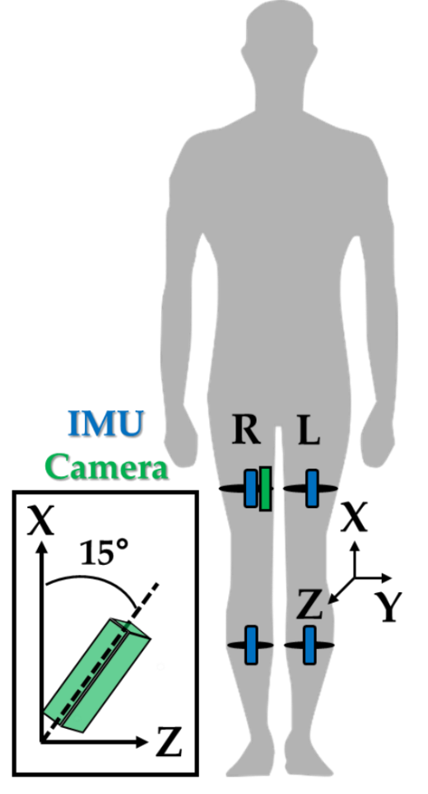
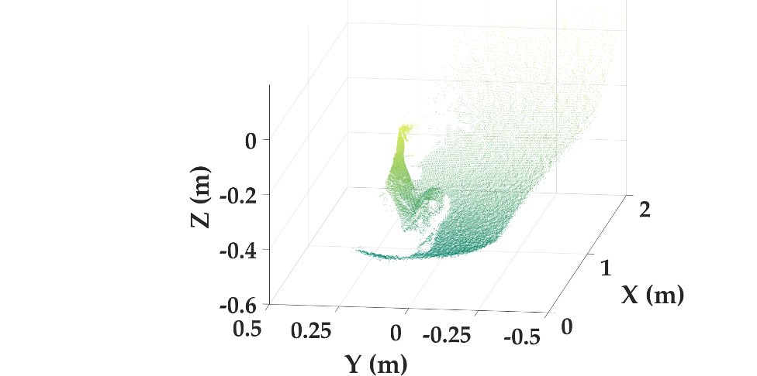
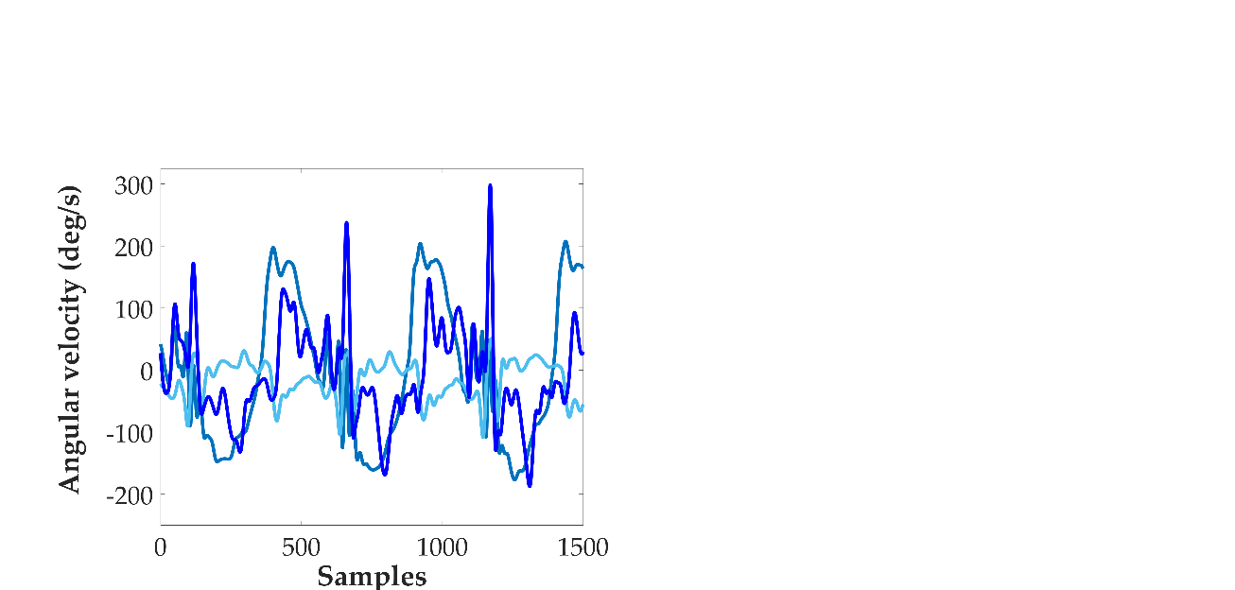
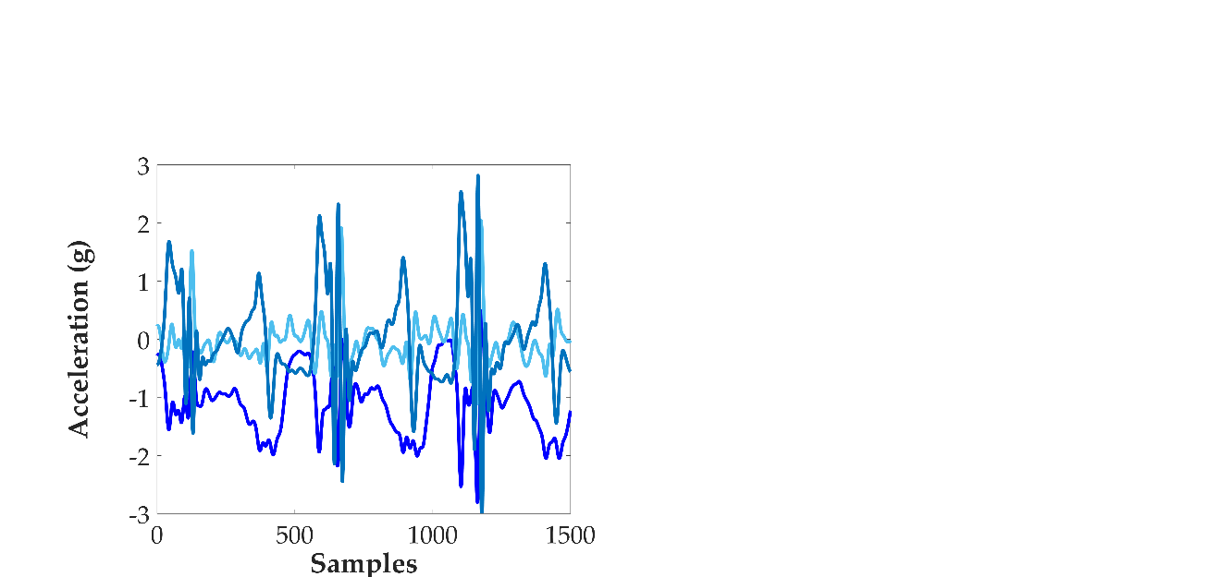
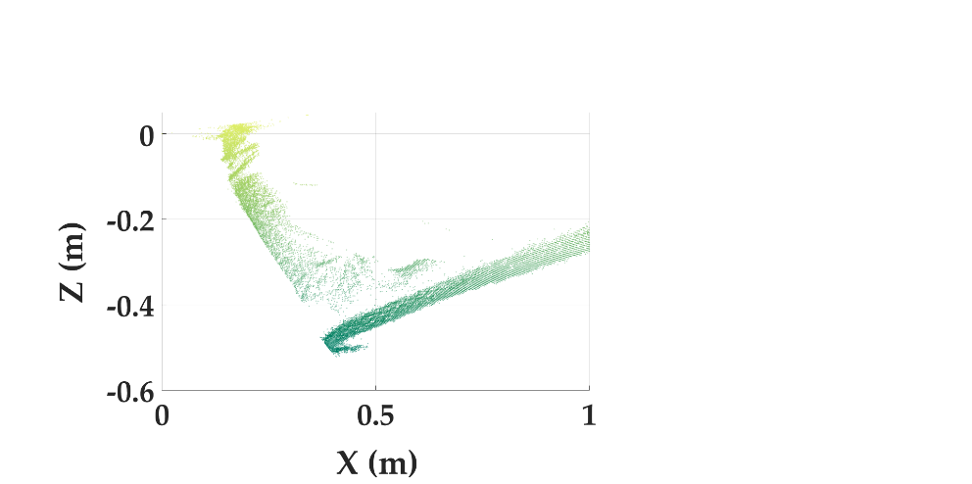
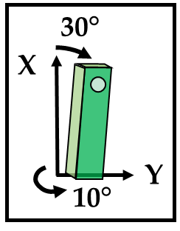
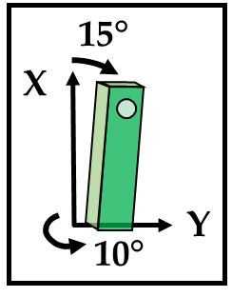
30°
X
Camera
IMU
Y
10°

Slide 14
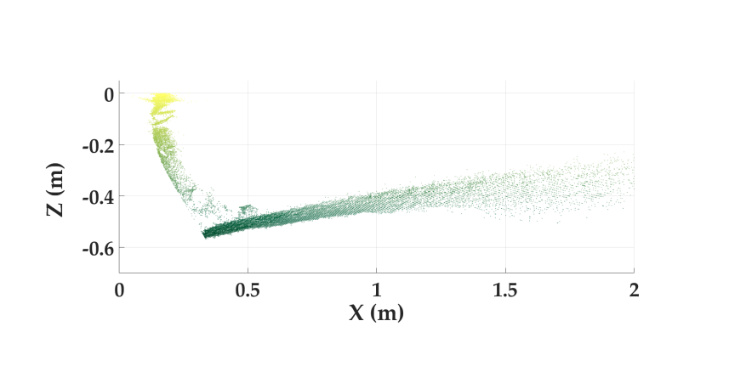
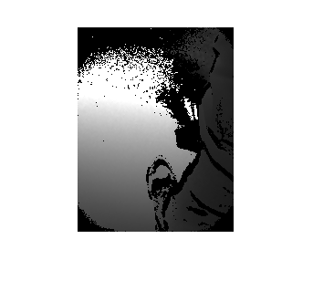
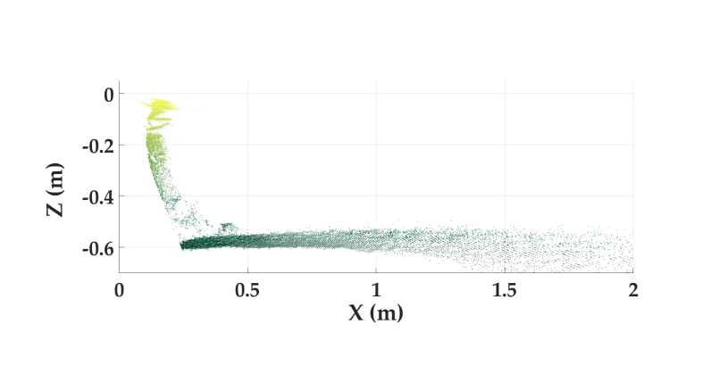
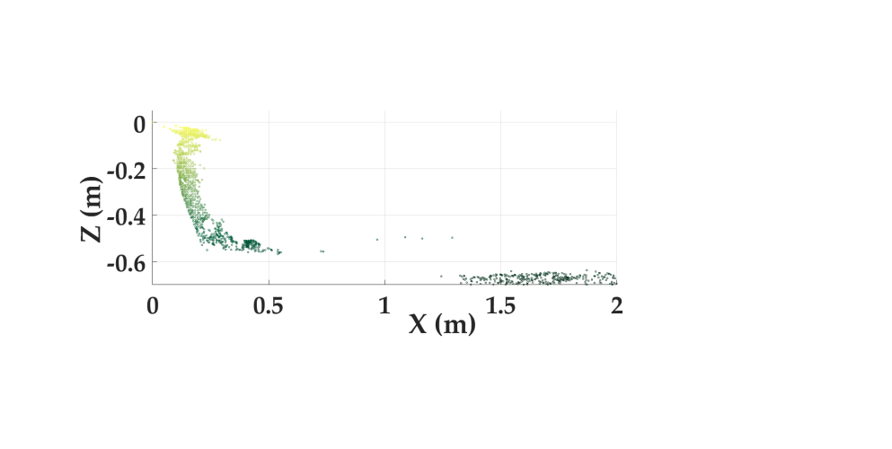
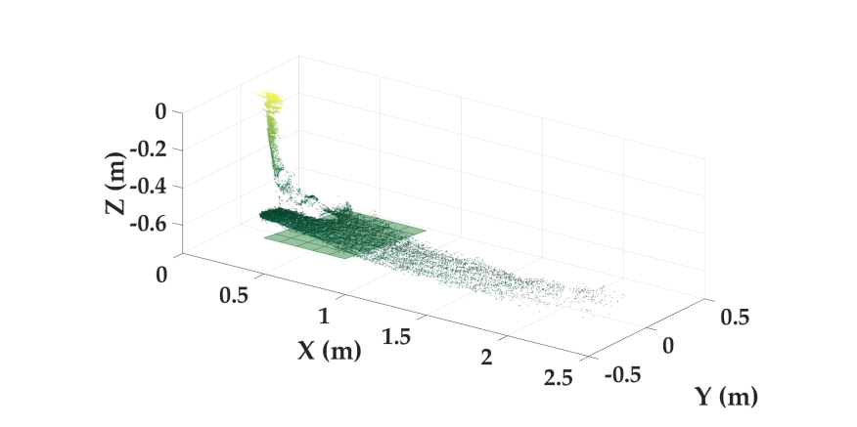

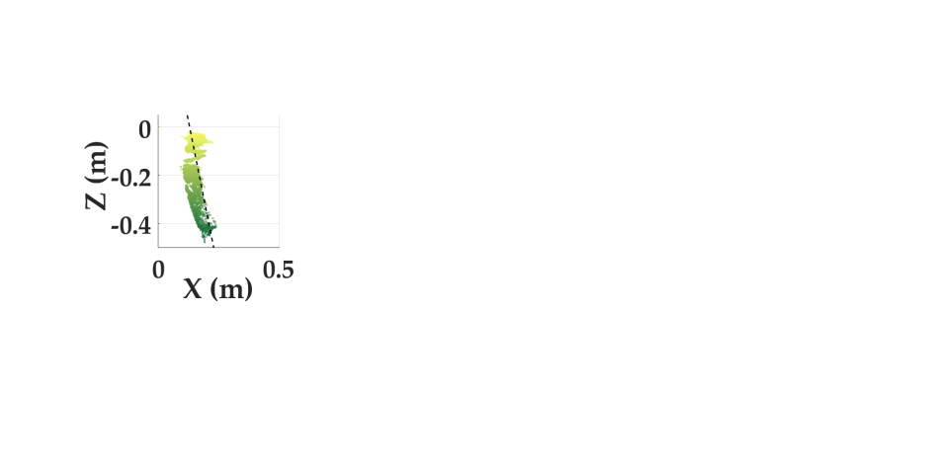
Raw Data
Depth data
2D Projection
Camera processing
Contralateral Foot and Shank
A. Ipsilateral
B. Contralateral
1A) Remove Initial Rotation
1B) 2D Ground Removal
2A) RANSAC Ground Fit
Ground Angle, θ
Shank Angle, φ
2B) Morphological Filtering & CCL
3B) Shank Linear Fit

Slide 15

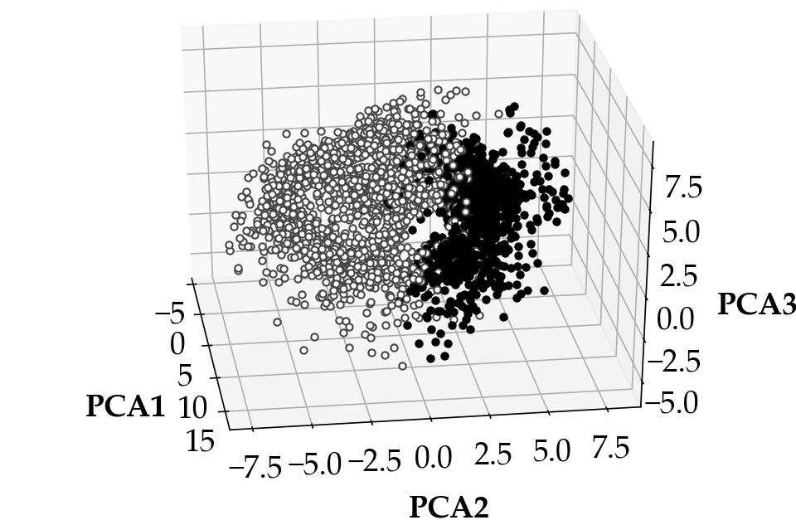
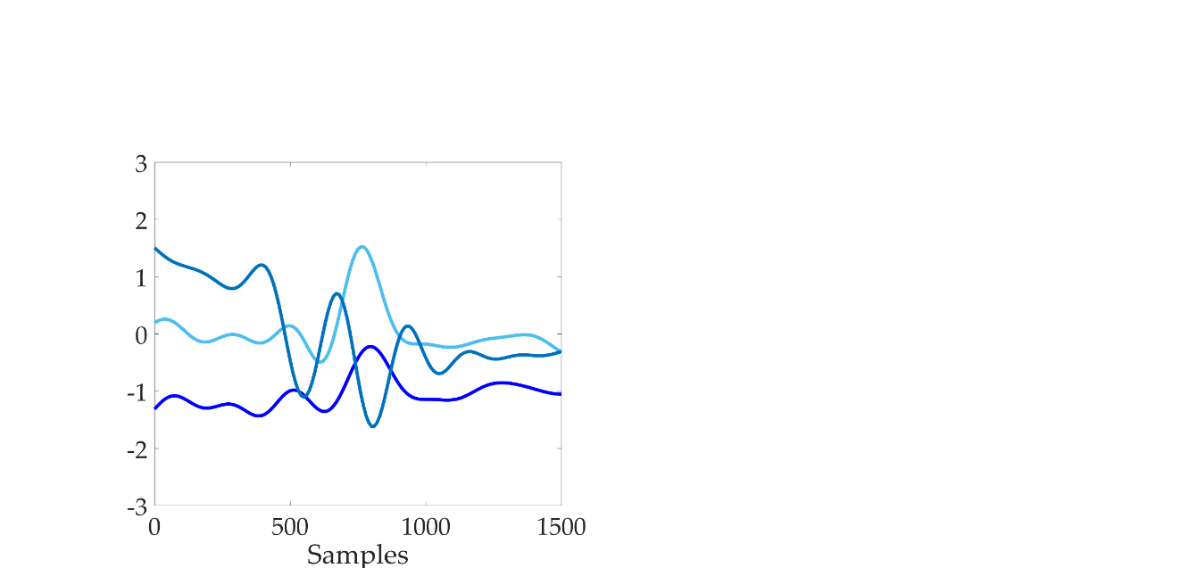
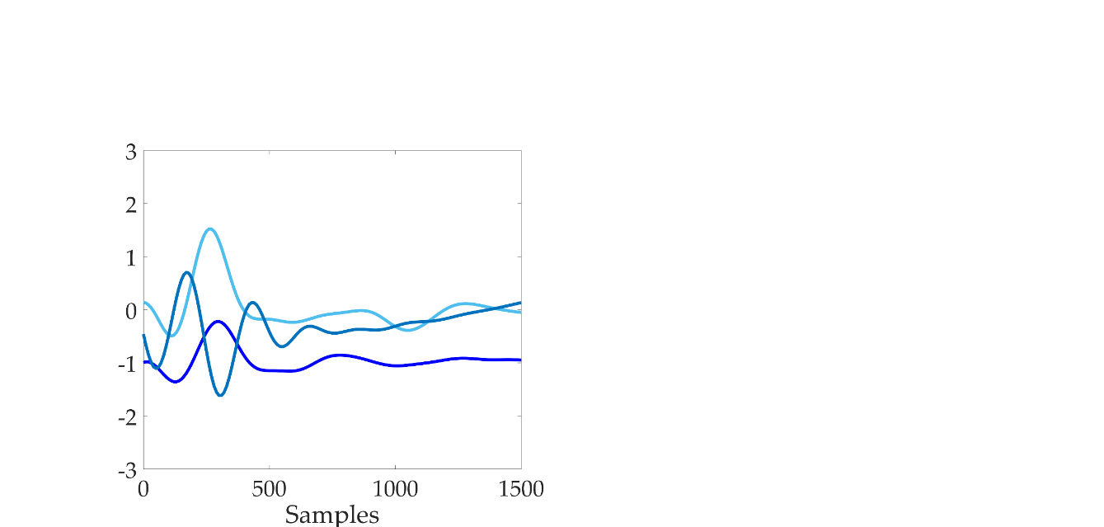
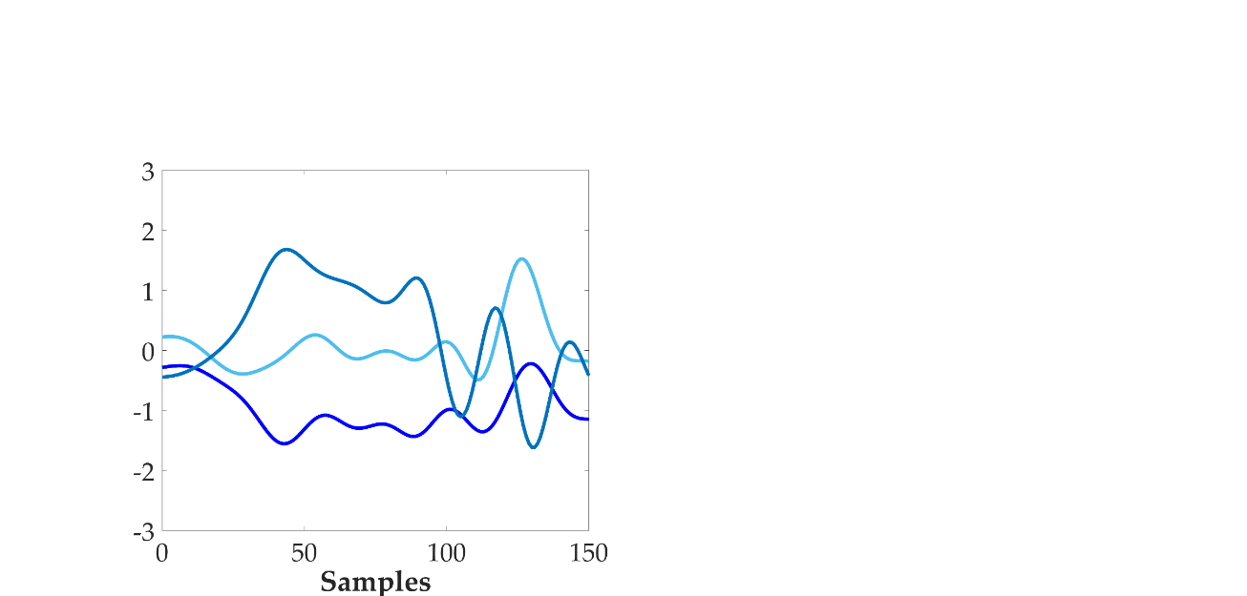
Windowing
Feature extraction
Classification
Stance
Swing

Slide 16
Windowing
Feature extraction
Classification
Stance
Swing

Slide 17
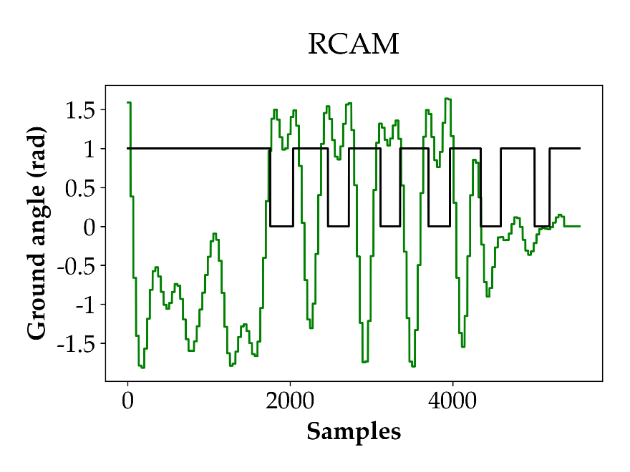
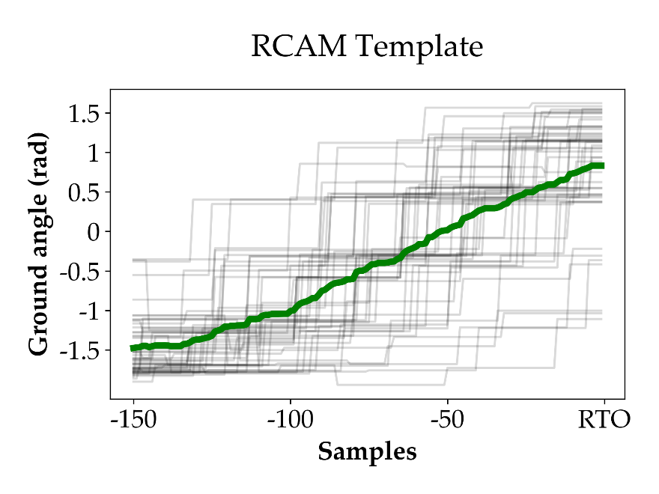
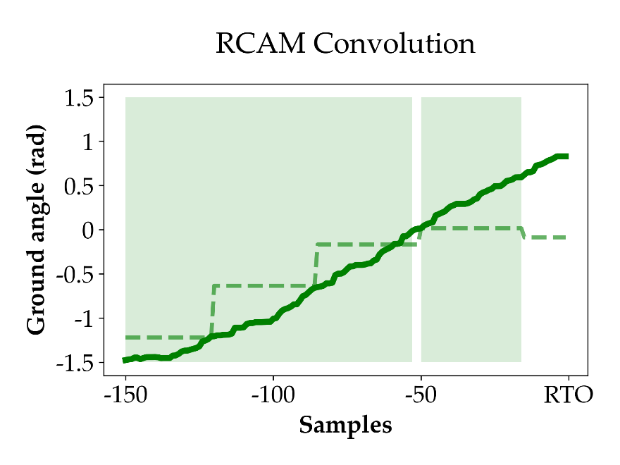
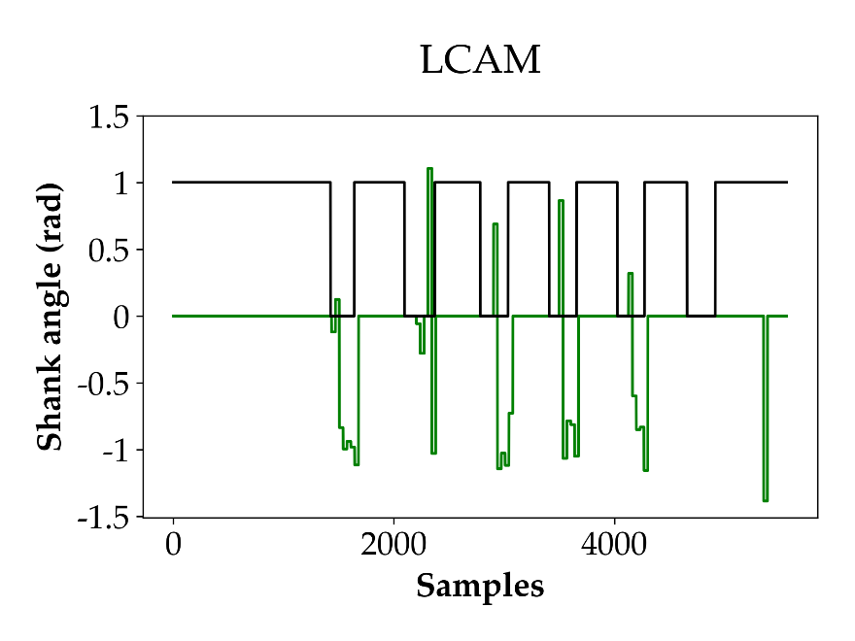
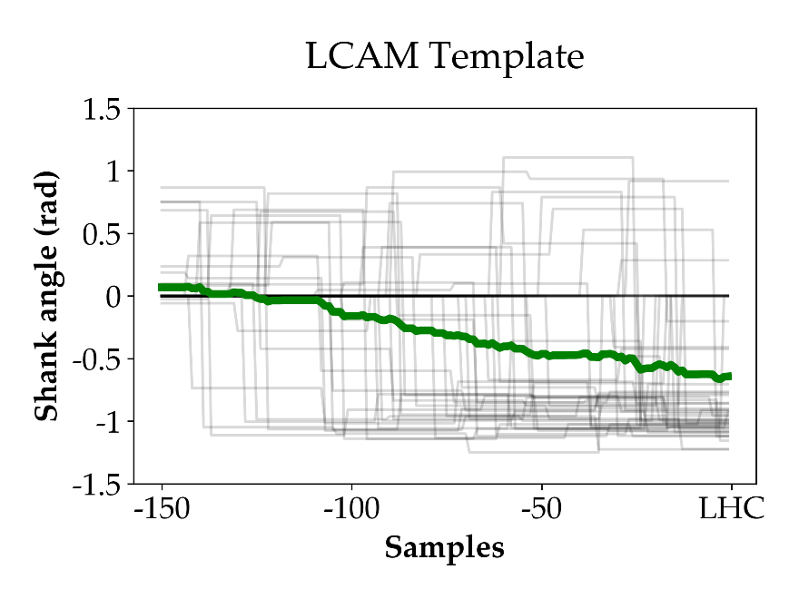
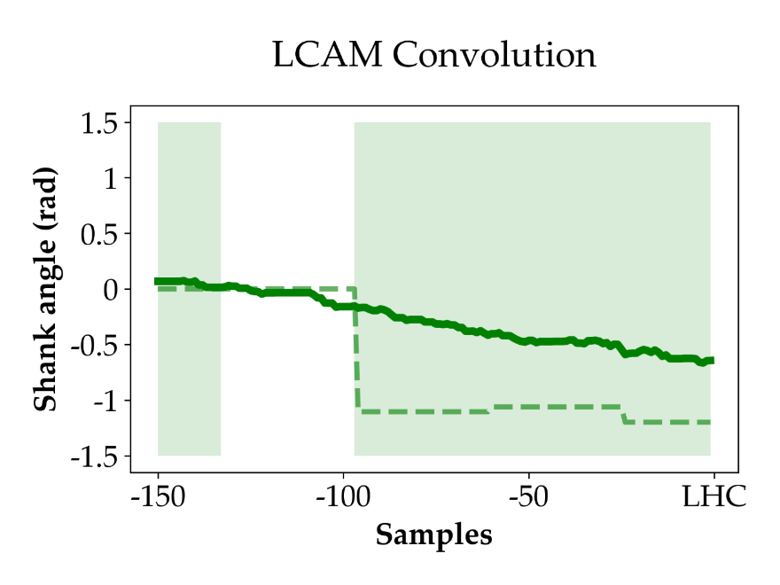

Slide 18
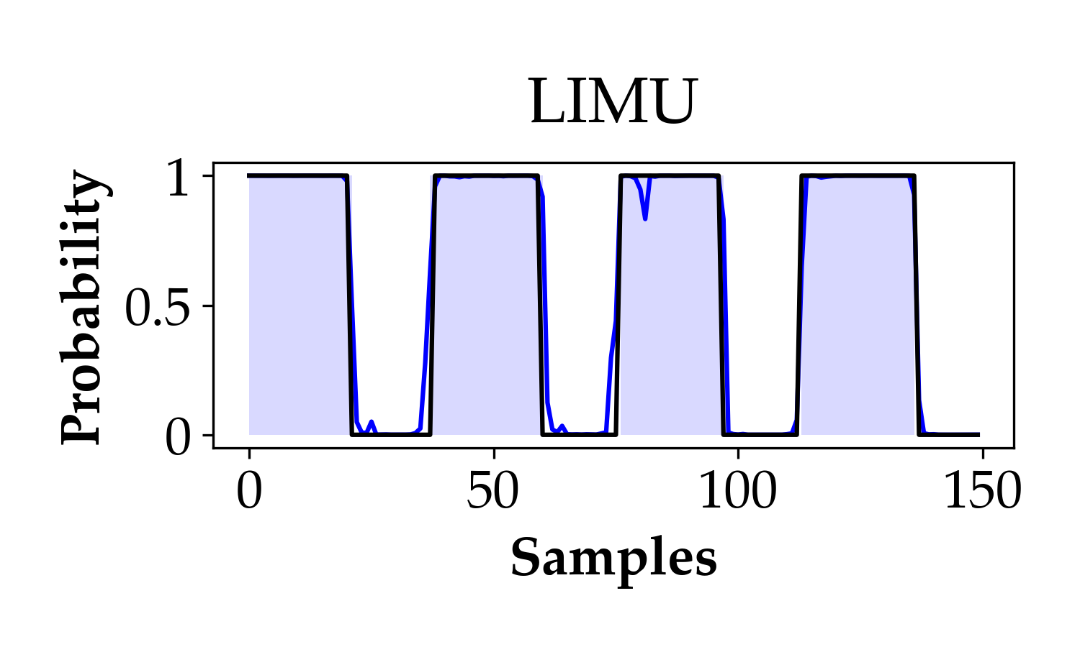
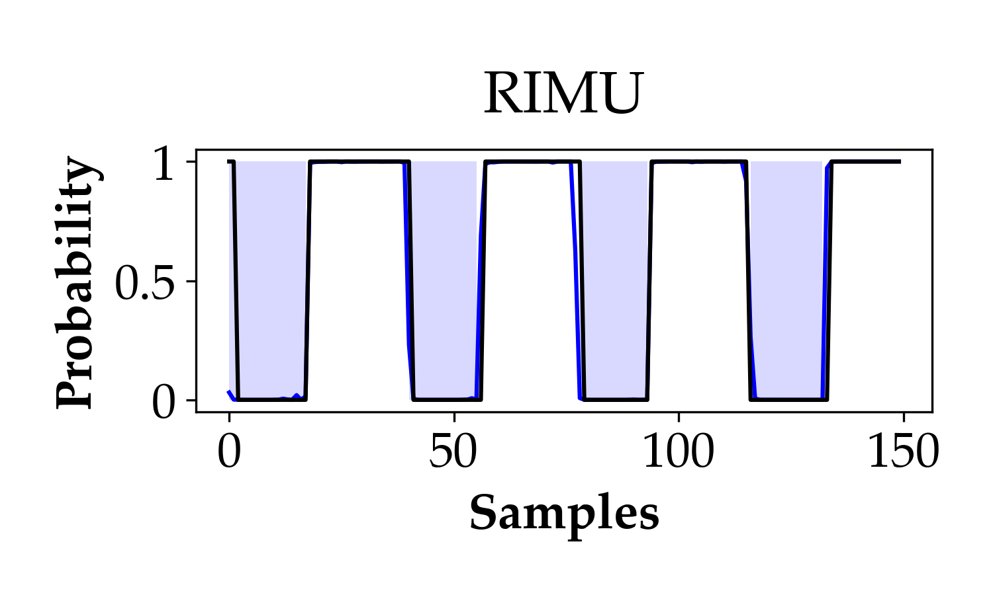
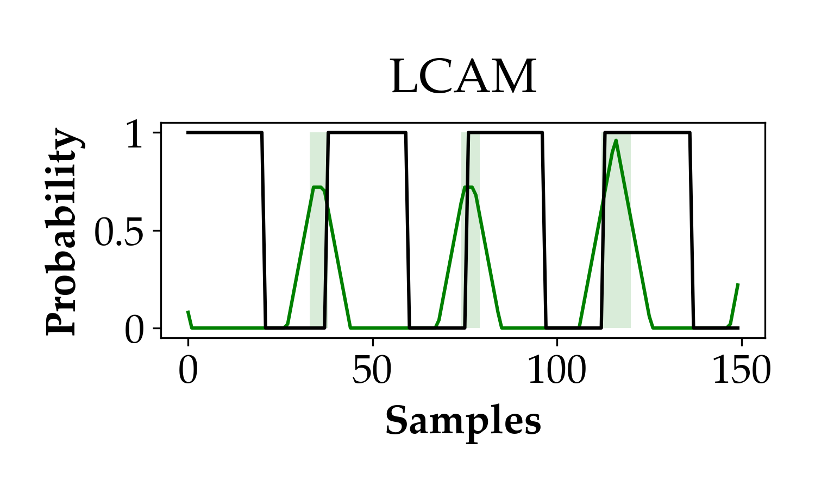
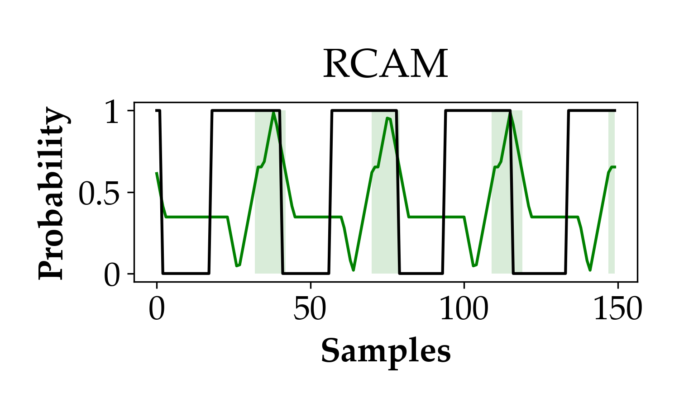
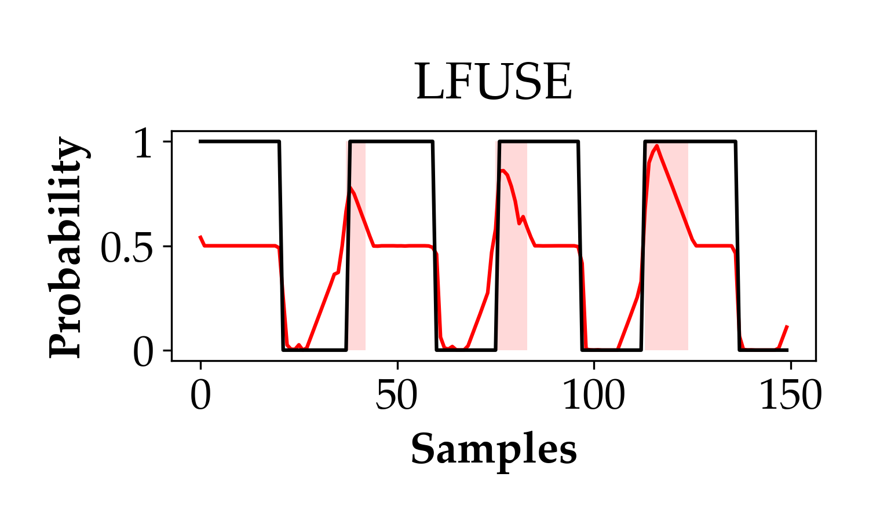
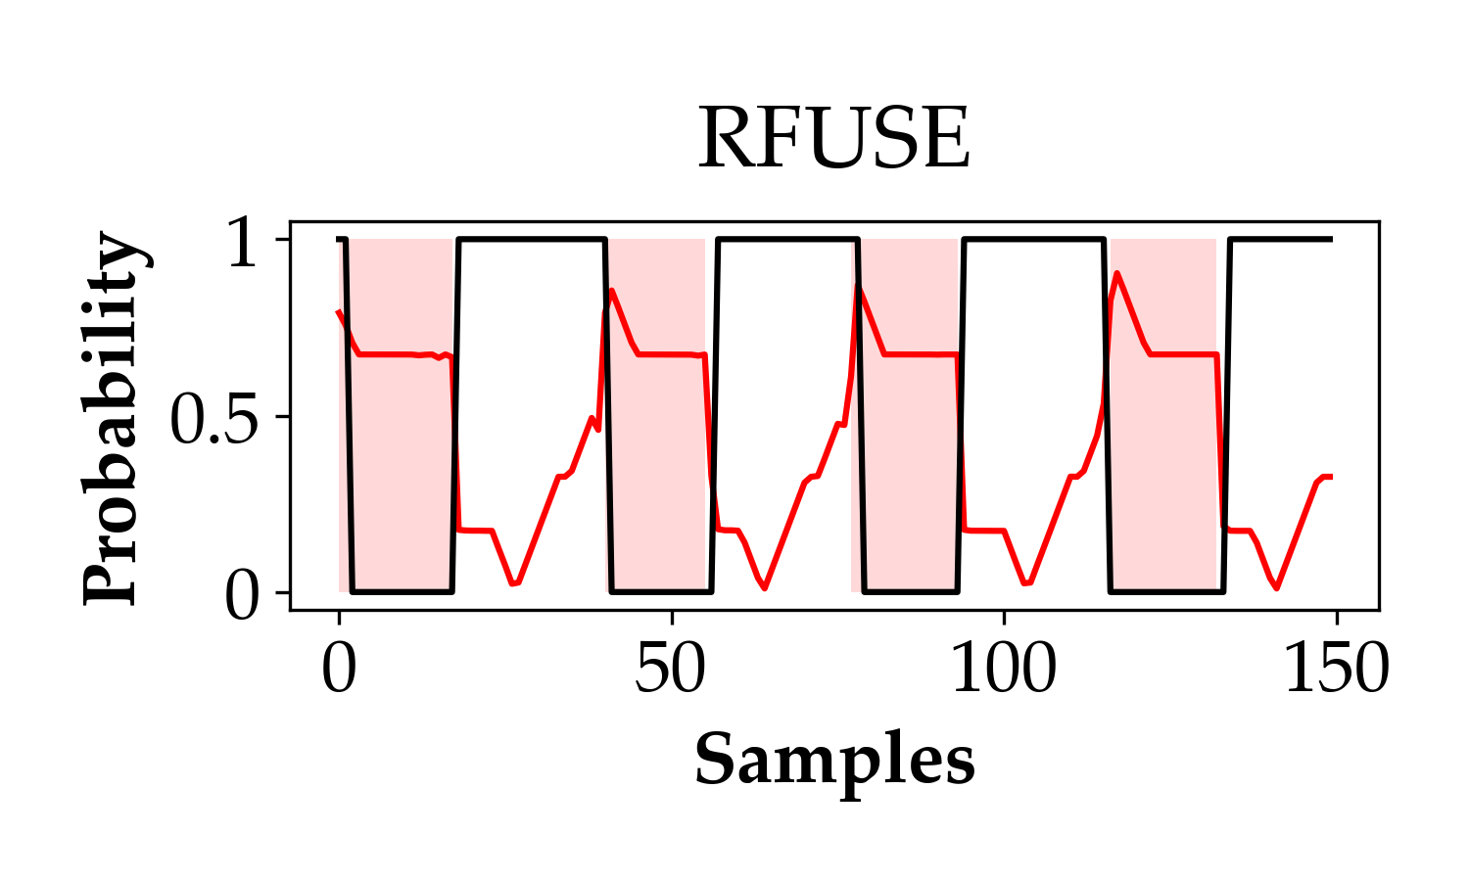

Slide 19
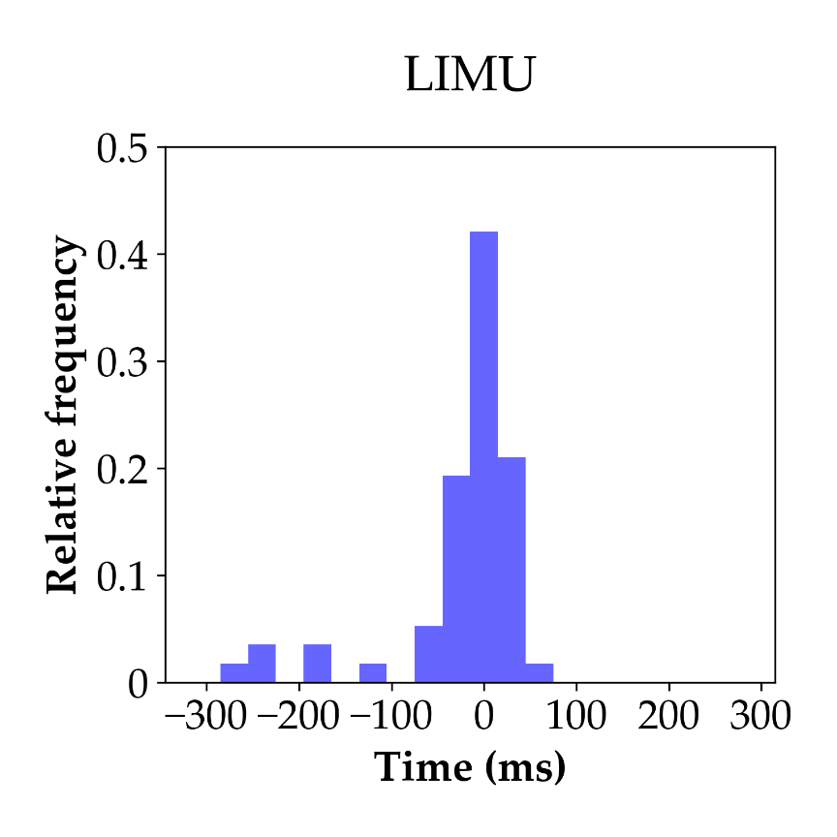
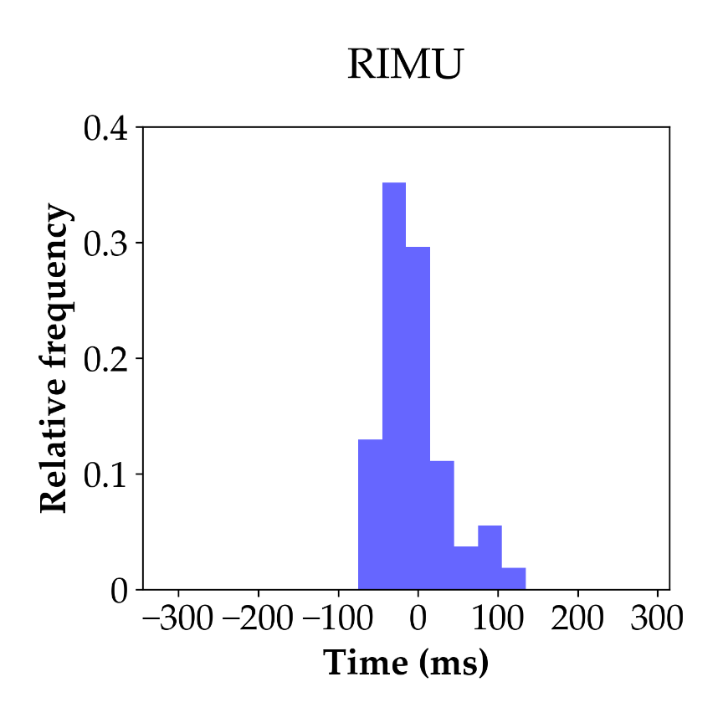
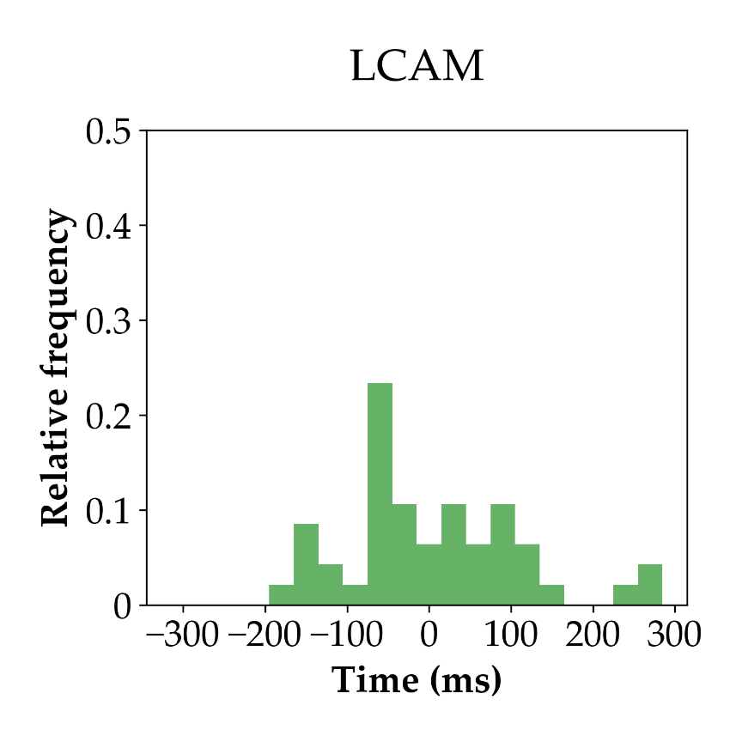
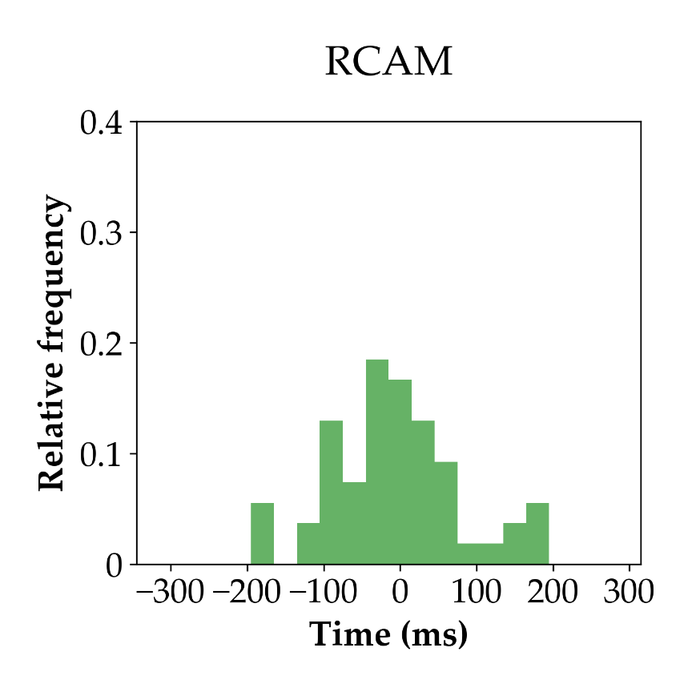
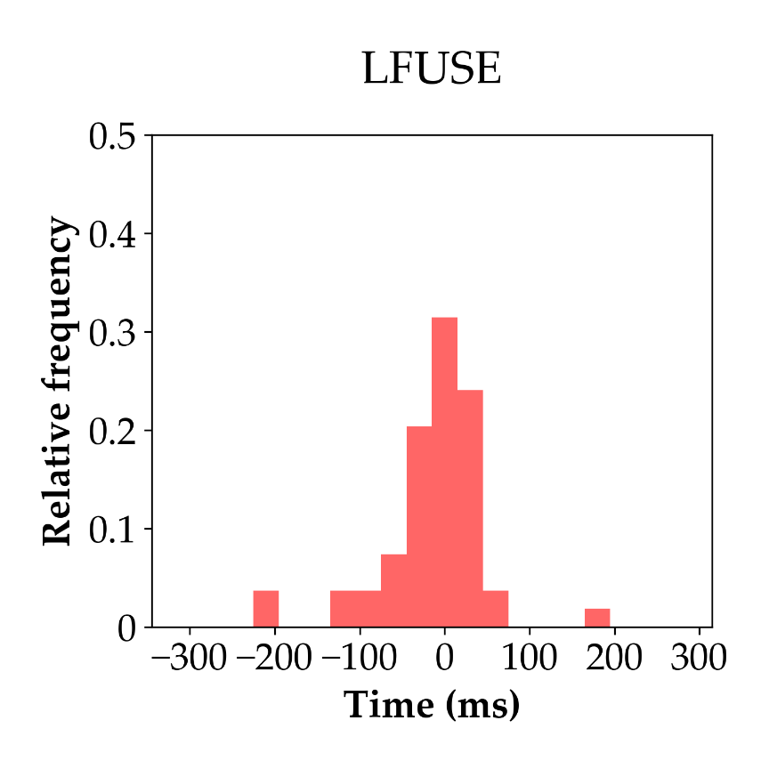
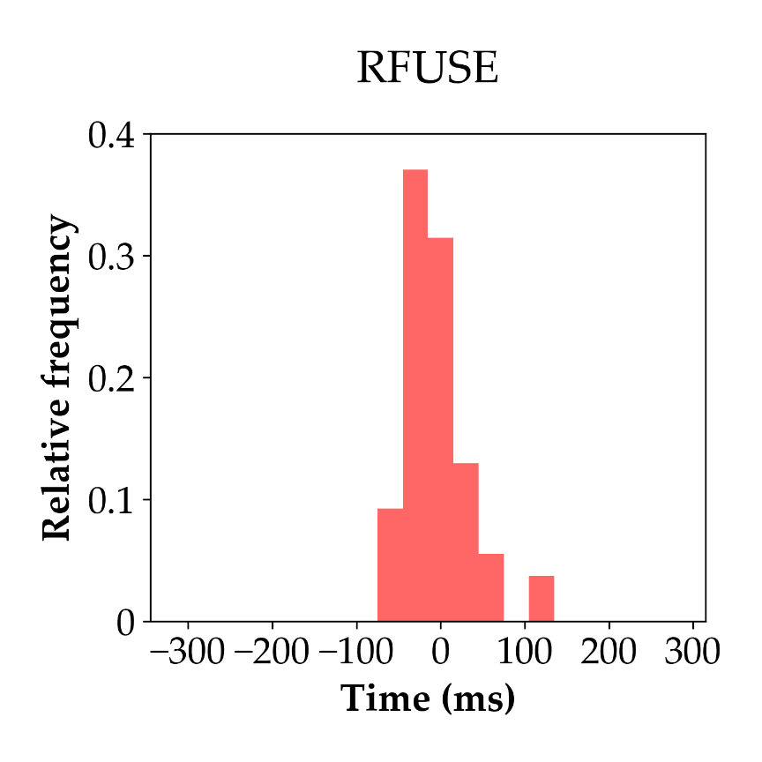

Slide 20
